Slide 1
American Private Enterprise System
College of Agriculture, Food and Environment

Slide 2
American Private Enterprise System Youth Seminar
American Private Enterprise System Youth Seminar (Takes place in Summer)
  College Tours
  Workshops
  Win Scholarships
  Meet new Friends
  Learn about Cooperatives/Corporations
  Looks Great on a College Application!

Slide 3
Overview
Part I: How America Is Organized to Do Business
Part II: Our Economy—How It Works, What It Provides
Part III: The Role of Government in Our Economy
Part IV: How to Do Business
Part V: Sole Proprietorships and Partnerships
Part VI: Investor-Owned Corporations and Limited Liability Companies
Part VII: Cooperatives
Part VII: E-Commerce

Slide 4
How America Is Organized to Do Business
How America Is Organized to Do Business

Slide 5

Economic Systems
How it all Started?
Over 200 years of existence, US is an economic wonder
Economic Systems are at the origin
Refers to a process through which labor, resources, and skills are brought together to produce and distribute the enormous variety of things people need and want e.g. goods- food, clothing, cars, factories, etc. services- transportation, education, healthcare, public safety, etc.

Slide 6

Since there are limits on what we can produce… There are 3 Basic Questions??
Economies must answer…
What to Produce?
How to Produce it?
For whom to produce it?

Slide 7
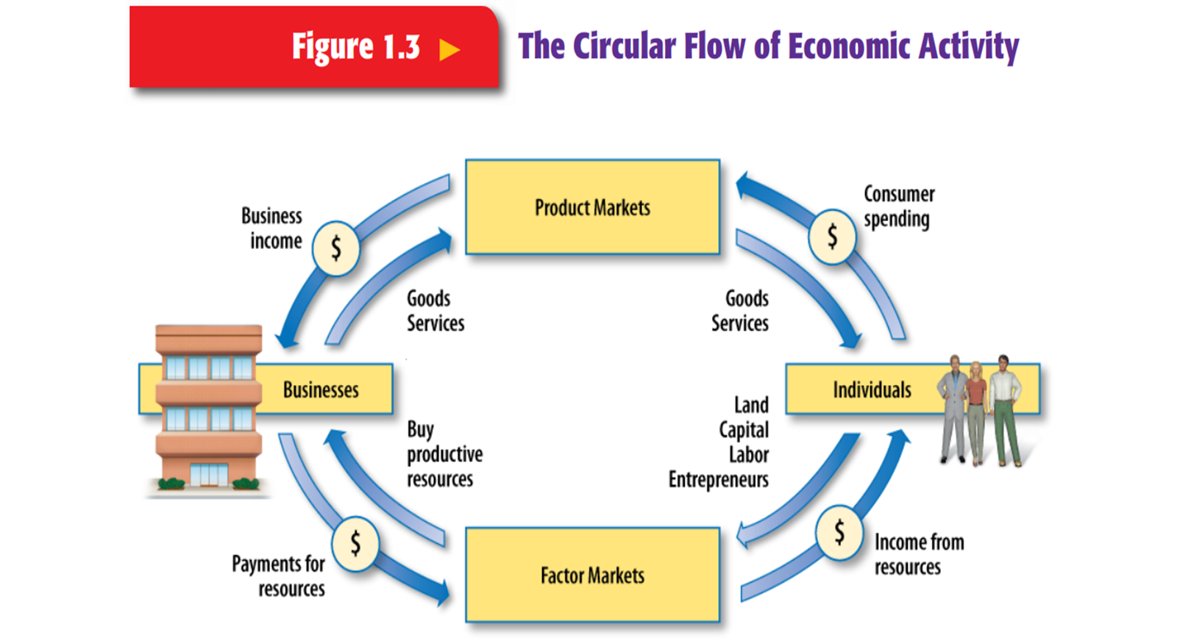
Circular Flow of Economic Activity

Slide 8

Comparing Economic and Political Systems
Different ways of answering the 3 questions
Knowledge of economic systems in other parts of the world can help us understand our American economic system better.

Slide 9
Comparing Economic and Political Systems (Examples)
Capitalism- Market where resources are primarily owned by private individuals and groups
Socialism- Economy depends heavy on the government to plan and make economic decisions and to own and control important economic resources
Communism- Describes socialist economy ruled by a single political party that controls the use of all economic resources

Slide 10
Three Forms of Political Economies and How They Work Today
Capitalism
PRODUCTION: Private individuals own land and businesses, operating them for profit. The market mainly determines what goods are sold at what prices.
PAY: Wages are set between employees and management at individual firms, with workers often represented by unions.
GOVERNMENT: It regulates business largely by telling firms what not to do. It stimulates output through incentives and usually provides tax-supported social benefits.

Slide 11
Communism
PRODUCTION: The state owns the sources of production, and these are managed by bureaucrats. Central planners set production quotas.
PAY: Government sets wages. Free trade unions are taboo.
GOVERNMENT: The sole political party, the Communist Party, rules.

Slide 12
Socialism
PRODUCTION: Elected government gradually takes control of key industries. Authorities often plan output for use rather than profit.
PAY: Strong trade unions bargain with management and often serve as the fountainheads of socialism.
GOVERNMENT: It allocates resources and uses taxing power to redistribute wealth.

Slide 13
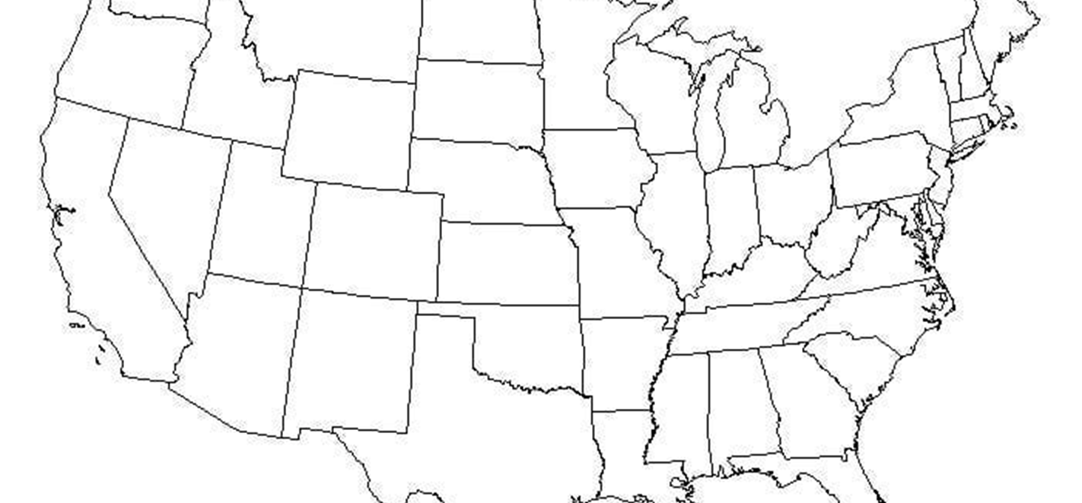
Which do you feel the US is most like?

Slide 14
Answer
Capitalism

Slide 15
Choices in the US
We are free to choose our personal goals and to decide how their work and resources will be used.
In other nations, only a small group of leaders have this power.
We have a market economy. It involves economic decision making by three groups: consumers, producers, and governments.
Our decisions are guided primarily by the interplay of buyers and sellers in the marketplace.
Market economies can exist in democratic political systems, as in the United States, or somewhat more authoritarian systems, as in Spain.

Slide 16
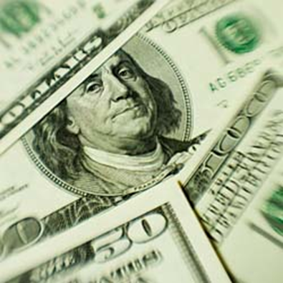
The extraordinary dimensions of our American
Economy—the things it provides
Gross Domestic Product
Income
National Income
Does anyone know what these things mean?

Slide 17
What Our Economy Provides?
Gross Domestic Product (GDP)- Measures the size of our national production
(add together the value of all goods and services for one year only measures final output)
Income- Earn income by being paid for applying our skills, efforts, and resources to some productive purpose
National Income = GDP + receipts of income from abroad, payments abroad, consumption of fixed capital, taxes, and subsidies

Slide 18
World Trade: A Pocketbook Issue for Everyone
U.S. is becoming more dependent on other nations
Foreign economic condition and exchange rates
U. S. and WWII
Exchange Rates- deals between countries are affected markedly by wide fluctuations in the value of each country’s currency
Tariffs- taxes a government places on internationally traded goods to protect its prices

Slide 19

The Need for Choices
All of our needs and desires cannot be fully satisfied
In American Economic system decision making is shared by consumers, producers, and governments.
Make wise choices!!

Slide 20

Thank you for participating in Section I!

Slide 21
Our Economy- How It Works, What It Provides
Section II

Slide 22
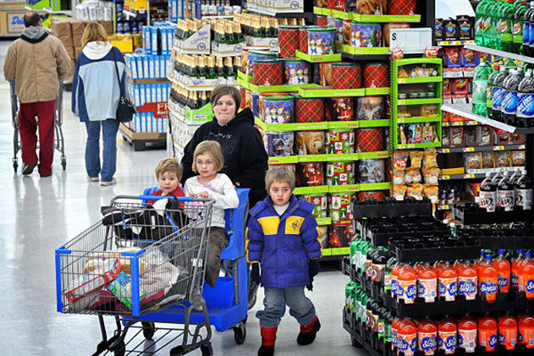
Consumers Play an Important Role in Economy
While members of all three groups—consumers, producers, and government—make decisions in our economic system, the key role that really makes everything work is played by you in your role as a consumer.

Slide 23
Our Economy, How It Works and What It Provides??
Consumers - Today, almost two-thirds of our nation’s total economic output consists of goods and services bought by individuals and households for personal us
Supply and Demand
  Supply: The amount of some product which is available to customers
  Demand: Our willingness and ability to spend our money for certain goods and services (price, quality, and availability of goods and services)
Credit and Savings
Producers

Slide 24

How the Work Force Is Being Transformed
Men and women in the workforce do far more than earn a livelihood.
Both consumers and producers of goods and services are sources of both the supply and the demand that drive the nations commerce
Nation Labor Force undergoing important changes
Wages and salary
Matching up jobs with qualified workers (Supply and demand)
Labor surplus

Slide 25

Changing Workplace
36% of the labor force hold manufacturing jobs
65% Service occupants- largest share
U.S. labor force growing rank of female workers

Slide 26
How Our Economy Fits Together
“Gigantic Machine”
Supply, Demand, Prices
Affect the wages we are paid
Cost of producing it and the selling price
Profit Margin- buyers are willing to pay more for a product than it costs to produce it

Slide 27

Competition
Key importance in the American economic system
Competition between producers
Competition causes our economy to change constantly

Slide 28
Productivity
People- their skills, efforts, and motivations
Capital resources- the availability and efficiency of factories and equipment
Technology- the application of sciences to industrial needs, involving new materials, new methods, and advanced processes
Organization- the effectiveness of management in combining resources
Government regulation- the imposition of standards and restrictions
Working environment- as it relates to both health and work attitudes

Slide 29
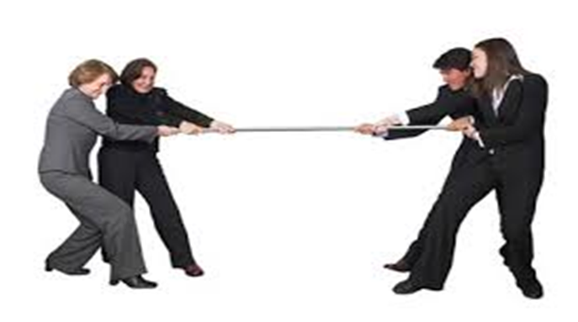
Balancing the Economy
Law of supply and demand
Determine levels of production and employment in our economy
Production goes down unemployment rise
Purchases increase, demand results in business expansion and higher employment
Employment Act of 1946

Slide 30

Pay Day!!!
Ready???!

Slide 31
The Role of Government in Our Economy
Section III

Slide 32
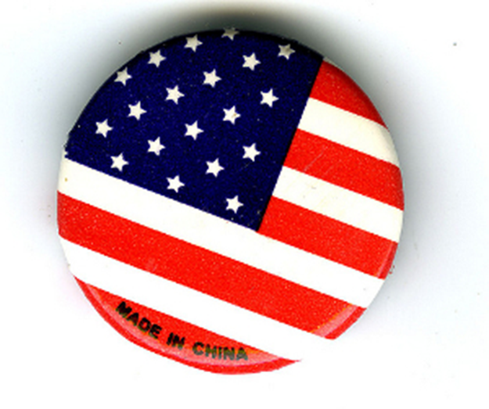
Government Involvement
There are five major areas in which government units (on the federal, state, and local levels) are involved in the economy.

Slide 33

Government Involved with Economy
Protection of rights and freedoms
Providing goods and services
Regulation
Promotion of economic growth and economic stabilization
Direct support to individuals

Slide 34

Protection of Rights
1. Protection of the rights and freedoms—economic, political, and religious—of individuals through our courts and the administration of our laws.

Slide 35
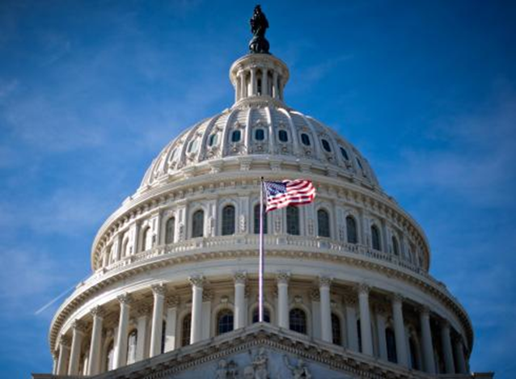
Interest of Us All
Providing goods and services in the interest of all of us—such as highways, national defense, and education.

Slide 36

Regulation
Regulation—the promotion of fair economic competition and the protection of public health and safety

Slide 37

Promotion
Promotion of economic growth and stabilization—through various economic policies and programs.

Slide 38

Direct
Support to Individuals
Programs to reduce hardships for individuals who cannot meet their minimum needs because of special circumstances or lack of employment.

Slide 39

Important Terms
Supply of Money
Inflation
Monetary Policy
Employment
Ever-Present Hand of the Government

Slide 40
Supply of Money
The supply of money has an important influence on spending and production, and banks play a central role in this process.
By changing the money supply, the Federal Reserve affects the amount of money banks can lend to individuals and businesses to spend.
The Federal Reserve generally makes money more available when total spending is considered too low and less available when total spending is too high. These actions directly influence interest rates throughout our economy.

Slide 41
Inflation
Inflation means a continual rise in the general level of prices.
Prices of most goods and services have increased significantly over recent years.
Prices often go up as the quality of the goods and services we buy improves.
When price increases not accompanied by improved quality are called inflationary.

Slide 42
Monetary Policy
The Federal Reserve System has responsibility for controlling our nation’s money supply—the total of all coins and currency in circulation, plus checking accounts held by individuals and businesses.

Slide 43
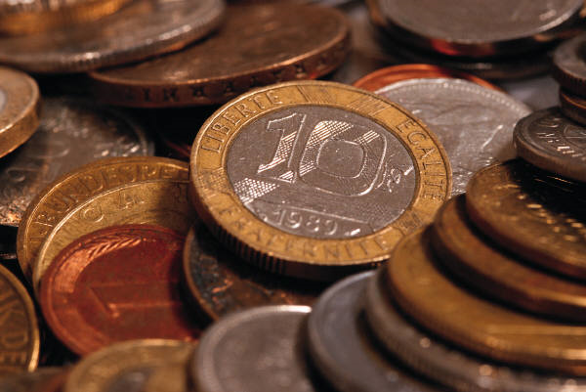
Economic Theories that Vie for Dominance
John Maynard Keynes
Other economist theories:
Monetarist
Supply Siders
Post Keynesians
Rational Expectations

Slide 44
Rational Expectations
Economists doing research on this theory attribute the failures of past government policy, in part, to the erroneous assumption that people would behave under new policies as they did under old ones.

Slide 45
Monetarist
Milton Friedman is the recognized leader
Contends that stable monetary policy, rather than
Activist budgetary policy, is the key to a smooth running
Inflation can be controlled only by maintaining a firm grip on the growth of the nation’s money supply.

Slide 46
Supply Siders
Divided into political and academic advocates.
Representative Jack Kemp (Republican from New York) has been the leading proponent of supply-side economics in the political arena.
Argued that deep cuts in personal and business taxes would produce such a strong recovery that the budget could be balanced with rising revenues and without substantial spending cuts.

Slide 47

Pay Day

Slide 48
How to Do Business
Section IV

Slide 49
Overview of How to Do Business
Business Organizations- produce or manufacture, distribute, or sell goods and services
Production of Basic Commodities- basic-raw goods and materials consumers- coal and oranges
Processing and Manufacturing- make basic commodities more useful to consumers
Marketing- selling and transporting products
Business Services- selling services instead of products to people or businesses

Slide 50
How Does Business Produce?
Basic Natural Resources
Labor
Capital
Management
Government
Capital Goods

Slide 51
What Business Does for a Community??
Provides our basic needs:
Food
Shelter
Clothing
Transportation
Communication
Services

Slide 52

Starting a Business
Entrepreneur
A person with a new idea who took a risk in the hope of making PROFIT

Slide 53
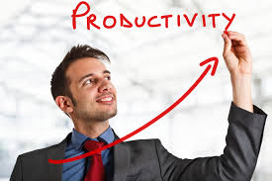
Problems of Productivity
Productivity
Output per worker per hour
Flood of inexperienced workers
Failure of firms
Implementation of technology

Slide 54

A Topsy Turvey Investment World
Core- financial system that puts money to work to make more money
Our economy relies on financial markets to funnel peoples savings into industrial expansion
Inflation
Double Digit Interest Rates
Stocks and Bonds
Raising the Money

Slide 55

In the Driver’s Seat
Board of Directors
Officers of the Company
Major stockholders
Outsiders who can provide useful connections with law firms, banks, investment houses, and customers

Slide 56

Stock Market
“Hub of the Investment World”
More than 40 Million individuals own shares in the U.S. corporations (valued at $1 Trillion)
Stocks can provide:
Dividend- profits a firm distributes to its shareholders
Capital gain- investor reaps when a stock is sold for more than the original PRICE

Slide 57

Stock Prices
Bear Market- prices are FALLING
Bull Market- prices are RISING
Influenced by:
Value of firms assets
Earning prospects
Investor demand

Slide 58
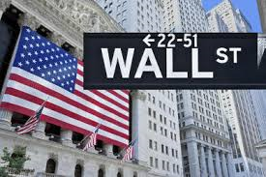
How the Market Works?
Buying and Selling Bonds
Less Risky than Stocks
Invest savings
Bond certificate
Hedging Bets
Buying or selling a stock at a current market price prior to the future date

Slide 59

Pay Day

Slide 60
Sole Proprietorships and Partnerships
Section V

Slide 61

Doing Business
Four Ways of Doing Business:
Individually owned business
Partnership
Corporation
Cooperative

Slide 62

Individual Ownership
“Oldest Form of Business”
Farms, local stores, repair shops, barbershops, restaurants, dental practices, and others
More dominant in farming than any other segment of our economy

Slide 63
Individual Owners
Serve the public. Owner buys and sells goods or provides services to whoever wants them
Little legal help is needed to start this kind of business.
Owners provides or borrows capital to start the business
Management is the responsibility of the owner
Individual owner can make all decisions and determine business policies
Owner receives the net margin, money left after the bills are paid
When the owner retires or dies, heirs may keep the business, sell, or close it

Slide 64
Advantages or Disadvantages of Individually Owned Businesses??
The business can be started quickly.
Decisions may be made quickly, policies changed.
The owner is responsible for management.
Business credit is only as good as the credit of the owner.
Large amounts of capital are difficult to obtain for business expansion.

Slide 65
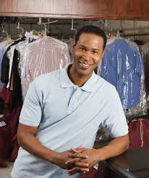
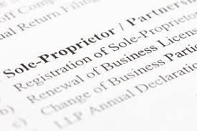
Sole Proprietorship
“Most common type of company”
72% of all firms
Bearing full success or failure of the venture

Slide 66

Business Partnership
Partnership- a voluntary association of 2 or more persons, as co-owners, to carry on a business for profit

Slide 67

Examples of Types of Partnerships
Creating a Partnership
Legal Considerations
Family Partnerships
General Partnerships
Limited Partnerships
Taxes in Partnerships
Partnership Advantages
Partnership Disadvantages
Terminating a Partnership

Slide 68

Thank you
This Concludes This Session

Slide 69
Investor-Owned Corporations and Limited Liability Companies
Part VI

Slide 70
“Never forget that you only have one opportunity to make a first impression with investors, with customers, with public relations, and with marketing.”

Slide 71
Corporations Defined
Defined as a legal entity separate and distinct from the shareholders who own it, from the individuals who manage it, and from its employees.
State chartered
Organized under the laws of the State where the corporation is headquartered
Stockholders are not responsible for the loss of the business

Slide 72
Corporations
Types
Four Kinds
  S Corporation-named because of its organization meeting the IRS requirements to be taxed under subchapter S of the Internal Revenue Code
  C Corporation – Traditional Corporation
  Professional Corporations
  Non-Profit Corporations

Slide 73
Corporations
Characterics
Considered a separate legal entity
Its shareholders are not personally responsible for the losses of the business.
Has most of the legal rights and duties of an individual.
For example, the corporation can enter into contracts, transact business, hold property, sue, and be sued.
It should be noted that it is the concept of legal separateness that sets the corporation apart from the partnership and sole proprietorship.

Slide 74

Steps in Forming a Corporation
Forming a corporation involves the transfer of money, property, or both by prospective shareholders in exchange for capital-stock in the corporation
Defined goals – Have to be clearly transparent.
Retain services of an experienced attorney (articles of Inc & legal docs)
Engage a certified public accountant to set up record accounts
Obtain a charter
Issue dividend stock
Elect Board of Directors, Adopt Bylaws (What are they)
Elect officers, set wage, and salaries
Establish the fiscal year

Slide 75

Corporations Legal Foundation
Articles of Incorporation
Total shares of stock corporation will sell?
Number shares owner will buy?
Amount of money or property owner will contribute?
The business of the Corporation?

Slide 76
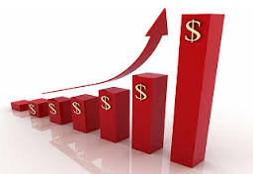
Who Owns the Corporation?
Stockholders or shareholders
  Investor-owned Corporations
Profit is the ultimate Objective
Stocks are bought and sold daily on the stock exchange
Derive capital funds by selling
To make profit, must invest!
T or F- The price of stock varies by day???

Slide 77
Corporations
Stock Exchange
Stocks are bought and sold on daily on the stock exchanges.
Where is the largest stock exchange?
  New York Stock Exchange
  Why would we be curious on what is going on in the stock exchange in Japan? Does it affect us?

Slide 78
Stocks and Non-Stock Corporations
Stock corporations, as the name implies, are corporations that raise a large percentage of their capital through the sale of stock to stockholders
A stock corporation may elect sub-chapter S status for tax purposes.
  Once made, sub-chapter corporation

Slide 79

Capitalizing on the Corporation
Long Term capital is needed for buildings, facilities
Short Term capital is needed for day to day operations
Issuing Shares of stock to acquire capital
To offset capital, borrow from banks, other financial institutions, and individuals

Slide 80

Controlling the Corporations
Majority stockholders
Board of Directors who are elected by the stock holders
Make decisions of corporation
Meet at least once a year
Officers elected by Board of Directors (President, Vice-President, Secretary, Treasury)

Slide 81
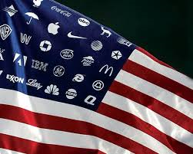
Advantages of Corporations
Advantages
Limited Liability
  (only lose extent of investment)
Continuity of Operations
Easy to add additional Investors

Slide 82
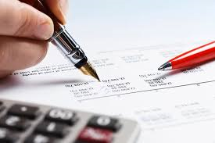
Taxing the Corporation
Taxed at two levels
Corporations pay taxes on profits
Individual shareholders pay taxes on profits
Double Taxation.”
  Corporation pays taxes on its profits, and shareholders must pay taxes on the dividends paid to them from the profits.

Slide 83

Handling Risk
Becoming very diversified
  When one part of operation falters, then opportunity for others to continue to do well
  Corporations have the largest business sales receipt

Slide 84
Corporations Conclusion…
Why Corporations?
  Corporations have the largest business sales receipt
  Many of the products and services sold to people now are too complex to be produced by small enterprises
  Economies of Scale
  Limited Risk- Legally, if a corporation goes bankrupt, the owners usually cannot be required to make good on unpaid debts
  Corporations are in the constant search for the right mix. By moving quickly into the most profitable fields and phasing out products that offer little opportunity, a company can do very well, despite economic downturns.

Slide 85
Investor-owned Companies
Characteristics
  Serves general public
  Business decisions are made by board of directors
  Net margins divided among stock holders or to expand business
  When a stockholder dies, passes to heir or can sell it
  Capital – issued by sale of stock
    Only responsible for amount invested
    Corporation can loose land

Slide 86
Limited Liability Companies
Blend of other Corporations, Partnerships, and Sole Proprietorships
Separate legal entity but can treat as a partnership for tax purposes
Profits and losses flow directly to the individual and are reported on the individuals tax returns
Forming LLC is much like a PARTNERSHIP

Slide 87
Limited Liability Companies Continued
Profits, losses, etc. flow directly through and are reported on the individual tax return
No statutory necessity to keep minutes, hold meetings, or make resolutions that can trip up many corporations
None of its members are personally liable for its debts
Unlike a corporation, must have two or more members. Corporation just one.

Slide 88

Who owns the LLC?
Individuals
Corporations
Other LLC’s
Trust
Pension Plans
Must have two or more members
Management is nested in its members
No one can join the LLC without the consent of the members having a majority intent unless the Articles state otherwise

Slide 89
Advantage and Disadvantage of LLC
Advantages
Owners, managers, and officers are not personally liable for the company’s debts
It does not pay taxes
It does not require as much paperwork or record keeping as a corporation
Disadvantages
It is not widely accepted since this is a relatively new form of company
It is difficult to transfer business in states not allowing this form of business
Its filing fee is usually much higher than for corporations

Slide 90
Sole Proprietorship, Partnership, LLC, and Corporations

Slide 91
Thank you
This Concludes this Session!

Slide 92
Cooperatives
Section VII

Slide 93

Introduction
Cooperatives
Cooperative is state chartered business
A cooperative seeks to realize economic benefits for its members from services that reduce cost, increase members’ income, improve quality, provide improved service, and develop the best use of members resources
Difference between cooperative and any other type of business is it OBJECTIVE

Slide 94

Cooperative Characteristics
Operates as an agent
Capital for Cooperative corporations may be provided by the sale of stock that has, by laws, a limited return, interest rate, or dividend
Managed by officers who are hired by the board of directors
Policies are decided at the annual meeting of members
Charge enough for goods and services to cover cost
Ownership if a member of a cooperative becomes an asset of the member’s estate at death

Slide 95
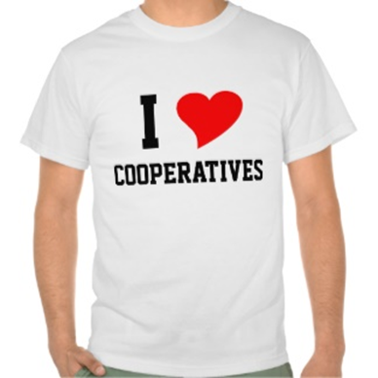
Three Distinctive Principles
Democratic Control
Limited returns on invested capital
Operation on a cost-of-doing-business basis

Slide 96
How Cooperatives are Organized
Articles of Incorporation
Specify the name or the corporation, its authority, its place of business, the number of directors, whether the capital is stock or non stock
Bylaws- tell how the corporation is going to operate
Marketing Cooperative may also have a marketing agreement with its members
Formal Application for membership, issue membership certificate, payment of membership fees, and refundable on termination of membership may also be required

Slide 97

Cooperatives Categories
Associations- serve local confined area
Regional Organizations- which encompass a much larger area
Federated Cooperatives- cooperative of cooperatives

Slide 98
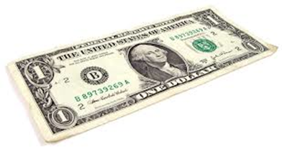
The Cooperative as a Business Firm
Four groups are involved in the operation of a cooperative:
Member patrons- owners
Directors- elected by the member patrons at the annual membership meeting
General manager- employees a staff and serves as the intermediary
Employees- answer to the manager

Slide 99
Financing
Capital
Members who invest in the cooperative to get needed services
Loans that are obtained
Funds for day to day operation
Obtained through day to day services provided
Revolving capital financing
As members do business through a cooperative they authorize the cooperative to use a portion of the money it has accumulated or saved through their patronage
Patronage
At the end of a fiscal year the member is notified or issued some evidence of the total amount he/ she has invested in cooperative capital for the year

Slide 100

Repayment
Goes first to the members who are the oldest in the revolving fund
No specific repayment date
Board establishes the revolvement fund periods
Revolving capital

Slide 101
Cooperative Service
Four basic Agricultural Cooperatives:
Marketing
Purchasing
Providing services
Providing credit
Marketing Cooperatives: benefit consumers as well as producers. ( Grade and Quality)
Purchasing Cooperatives
Effect savings for member patrons
Produce the type and quality of supplies best adapted to the members farms and needs
Provide related services that meet the needs of member patrons
Credit Cooperatives- farmers borrow from local credit cooperatives

Slide 102
E-Commerce: A New Way of Doing Business
Section VIII

Slide 103

What Is E-Commerce?
The definition used in this section explains electronic commerce or e-commerce.
Any type of business or commercial transaction that involves the transfer of information across the internet.

Slide 104

Types of E-Commerce
a range of different types of businesses, from consumer based retail sites through auction or music sites to business exchanges trading goods and services between corporations.
a variety of post and presale activities and it is currently viewed as one of the most important aspects of the Internet to recently emerge.

Slide 105
E-Commerce & Internet Use
Correlation
1997 18.0% of all households had internet use at home.
Fifteen years later, 74.8% of all households had internet use
78.9% of people have a computer at home
94% utilize the computer to connect to the internet.
2012, 45.3% of adults 25 and over using smartphones that have internet access.

Slide 106
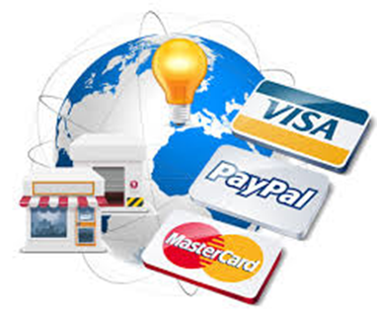
Types of E-commerce
Business to Business (b2b)
Business to Consumer (b2c)
Consumer to Business (c2b),
Consumer to Consumer (c2c)

Slide 107
Business to Consumer
B2C (Business to Consumer)—this form is the common association of "e-commerce."
It encompasses businesses selling to the general public through shopping cart software, without needing any human interaction
Amazon is an example.
In 2012, B2C ecommerce sales. Grew 21.1% to top $1 trillion for the first time,
This year, sales will grow 18.3% to $1.298 trillion worldwide.
eMarketer estimates, as Asia-Pacific surpasses North America to become the world's No. 1 market
Sales in Asia-Pacific grew more than 33% to $332.46 billion in 2012.
This year, the region will see sales increase by more than 30% to over $433 billion—or more than one-third of all global B2C ecommerce sales.

Slide 108

C2B (Consumer to Business)
In this scenario, a consumer would post a project with a set budget online, and companies bid on the project. The consumer reviews the bids and selects the company—Elance is an example of this type of e-commerce.

Slide 109

Consumer 2 Consumer
C2C (Consumer to Consumer)—this type of e-commerce is made up of online classifieds or forums where individuals can buy and sell their goods.
A payment system such as PayPal enables customers to pay in a consumer to consumer type of e-commerce.
eBay or Etsy.

Slide 110
Benefits of E-Commerce
No barriers of time or distance.
Past five years resulting in more businesses transferring sections of their operations onto the internet, potentially cutting operation costs.
Cost Efficiency and Receiving the Best Price
Price is usually 2x to 5x the initial price
Benefit of Free
Free Shipping or Free Returns in case of wrong size or color
The Art of Individualism and Personal Satisfaction
Companies are offering clothing that is accustomed to fit the many types of bodies that resemble the consumer.
Accustom Apparel, which uses 3Dbody scanners along with pattern making software to scale the creation of custom fitted clothing at a digestible price point.
The Self-Appointed Shopper
Organizing a consistent purchase for the consumer to obtain routine goods and services. Some critics may view this as a lazy shopper, while others say it is a matter of convenience.

Slide 111
E-Commerce - Here to Stay
Projected that United States retail sales are expected to grow from $263 billion in 2013 to $414 billion in 2018, a compound annual growth rate of 9.5%,
69% of United States adults regularly buy online and purchase about 16% of their products online.
By the year 2017, 60% of all United States retail sales will involve the Internet in some way.
The Future
The categories of goods that will be most influenced by Internet research in five years will be grocery, apparel and accessories, home improvement,

Slide 112
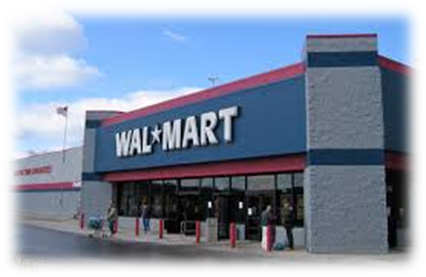
Examples
Walmart Mobile Apps
  Picks up discounts and detects when shoppers in stores
Pac Sun
  IPad order online items out of stock

Slide 113

International E-Commerce
China
Beauty Retailers have failed to adopt to China
32% no Chinese language site
Calvin Klein, Dior, Gucci, and Chanel).
20% of sales are online in China compared to 5% US
Nigeria
  Slow to adapt
  Huge future market
“African and Middle Eastern regions are among the least developed markets in e-commerce.”

Slide 114
Keys to E-Commerce
Showing taxes in a way that is familiar and easily understood.
Provide a means for a local payment that is quick and efficient.
In Germany, wire transfers are the most important local payment method
In Japan, the Konbini payment method is a popular alternative, representing nearly 40% of some of clients’ Japanese transactions.
A sound presentation can make a difference.
Exchange rates can cause friendly-looking price figures to turn to less rounded, odd looking numbers. If you show an EU customer a product priced at €23, 81 rather than a more customer-friendly price of €25, 00,
Flexible Pricing
Exchange Rates
1300 Pesos equivalent to 32 US Dollars
In Canada, US dollar worth 1.03 Canadian Dollars
Tennis shoes that cost $105 American dollars would cost $108.15 Canadian

Slide 115
Starting an Online Business
Registering a Domain Name
Select a Web Host
Design of a Website
Advertising and Marketing
Comply with Online Business Regulations
State and Local Compliance Information
Tax Requirements of Federal, State, and local Businesses
Understanding International Trade Laws
Resources to Consider When Starting a Business

Slide 116
E-Commerce
This concludes Section VIII on E-Commerce

Slide 117

Thank you!
Want to thank you for participating in the American Private Enterprise Program and being a Future Leader in your Community!!
We look forward to seeing you at the Kentucky Youth Seminar this summer…..

